Slide 1
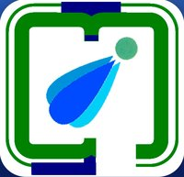
PDPM Indian Institute of Information Technology
Design and Manufacturing
Jabalpur
PR-201
Topic: Coping with Dyslexia
Supervisor : Dr. S.K.Mohanty
Team Members:
Aditya Verma 2016011
Isha Agrawal 2016108
Jagriti 2016111
Nitin Kumar Sharma 2016242

Slide 2
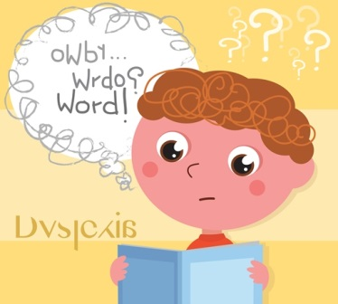
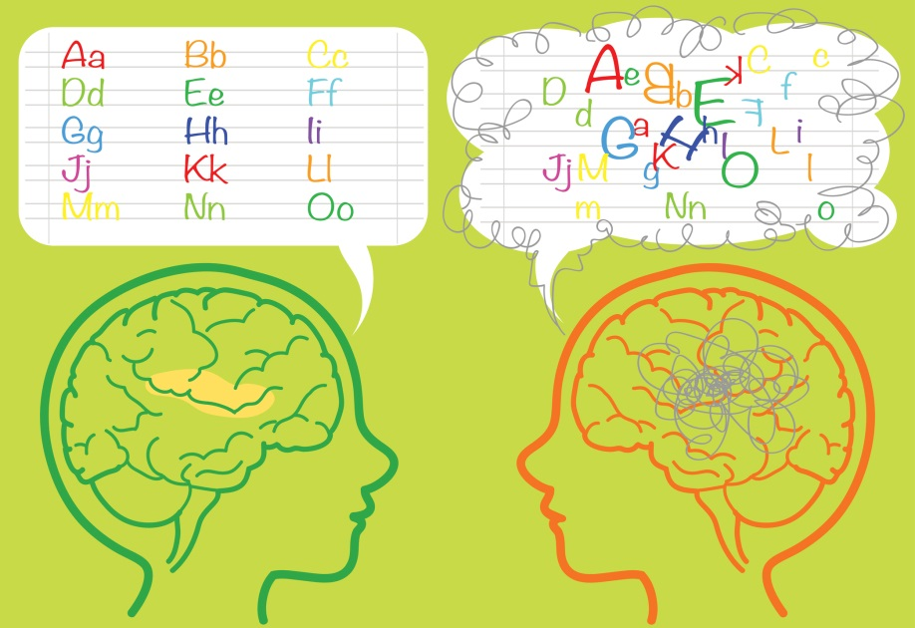
What is Dyslexia?
Dyslexia is a specific language disorder that causes problem in reading, writing and speaking.
It is neurobiological in origin.
It is characterized by poor word recognition, spelling and decoding abilities despite having higher cognitive abilities and receiving effective classroom experience.

Slide 3
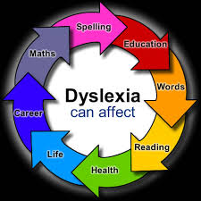
Why it is necessary to find a solution?
It can be estimated that teachers will have between one and five dyslexic students in each class.
If left untreated, dyslexics will develop low self-esteem and poor confidence.
They will develop emotional problem because of inferiority and frustration .
It will affect their education as well as social and personal life.

Slide 4
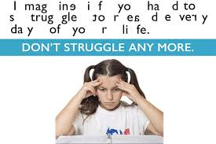
Controversies
Some researchers claimed it to be just a visual issue.
Studies found children with dyslexia and without dyslexia to have similar visual conditions.

Slide 5
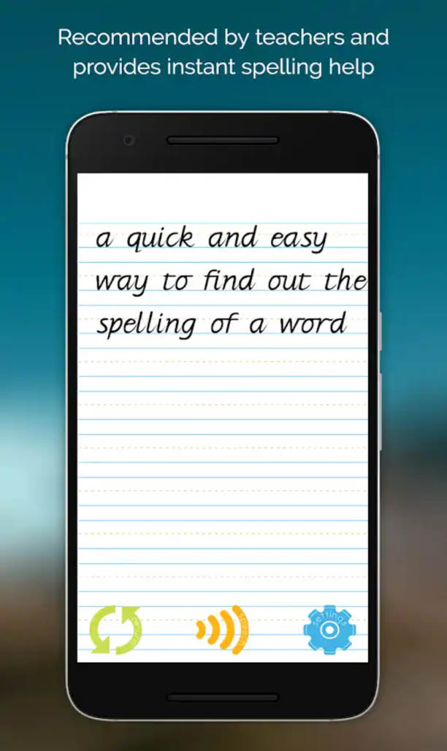
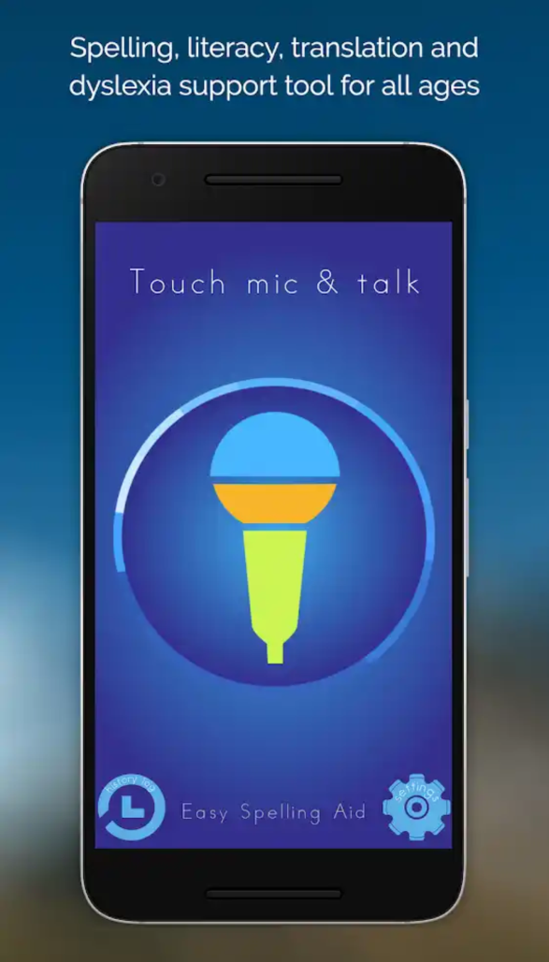
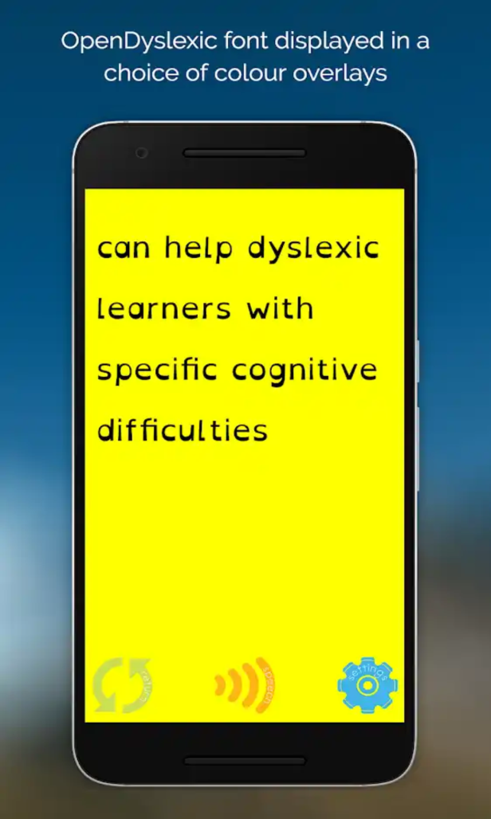
Existing tools for dyslexics 1-Easy spelling aid+translator

Slide 6
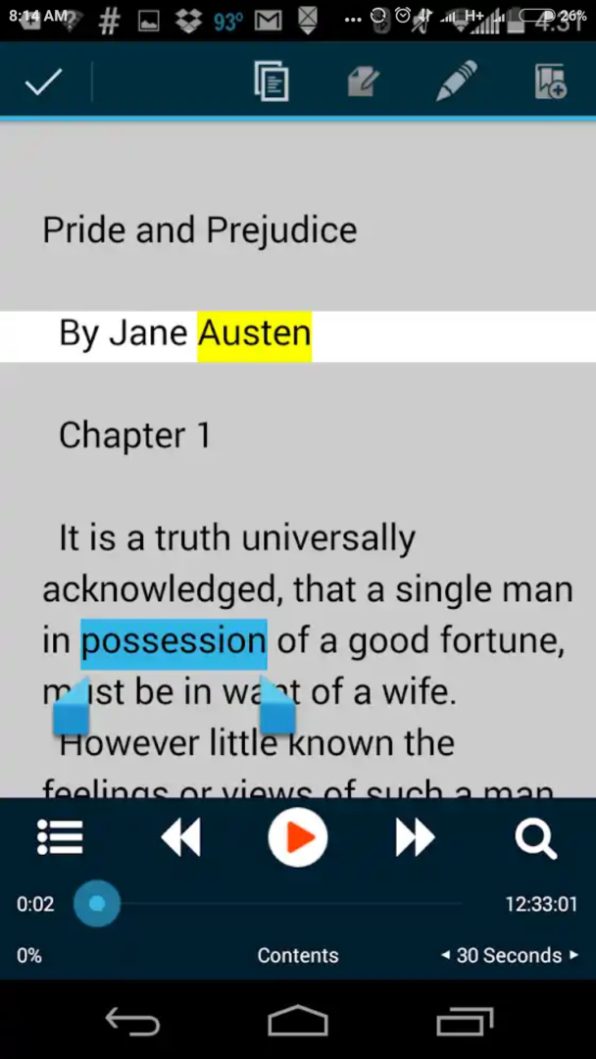
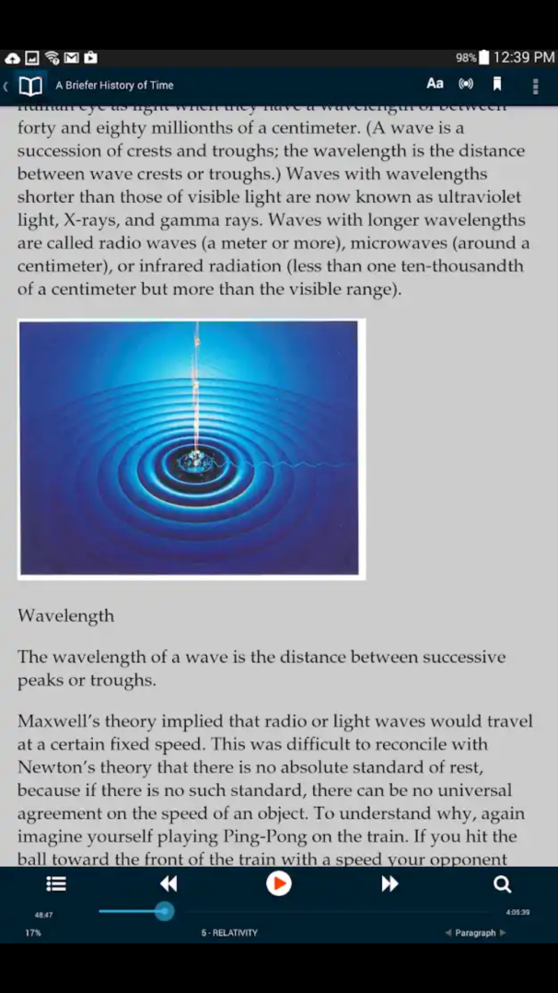
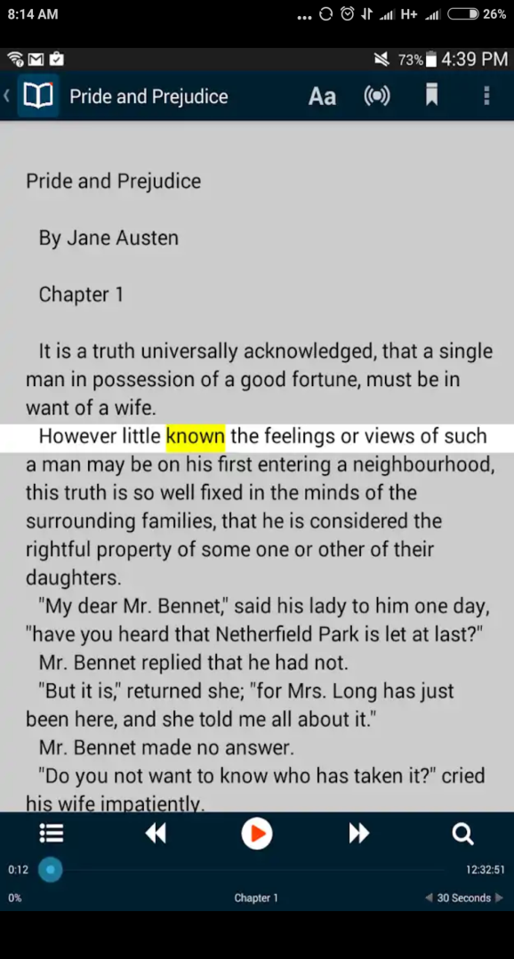
2 – Voice dream reader

Slide 7
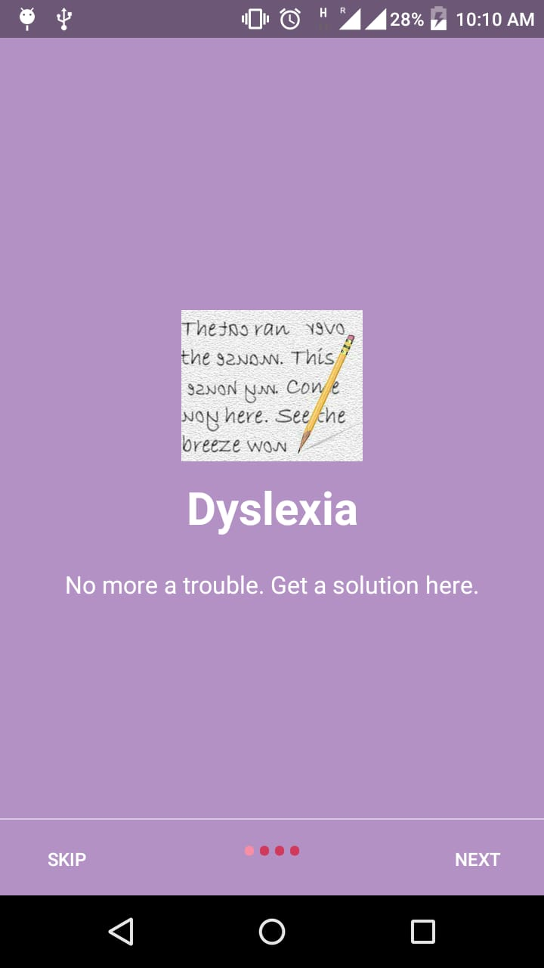
Solution we present
An easily available, less expensive and safe online tool for dyslexics.
We made an android application for dyslexics.
Very easy to follow steps to use.
Can regularly practice and instantly get solutions for their problems.

Slide 8
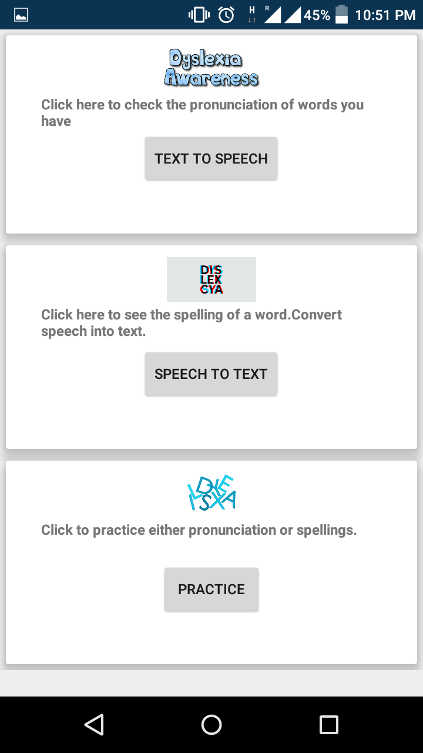
Android Application
An Android application for practicing spelling
and pronunciations of words.
Application is memory efficient.
It is secure.
Used android APIs
Main Features of application include:-
1) Text-to-Speech
2) Speech-to-Text
3) Practice spelling and pronunciations

Slide 9
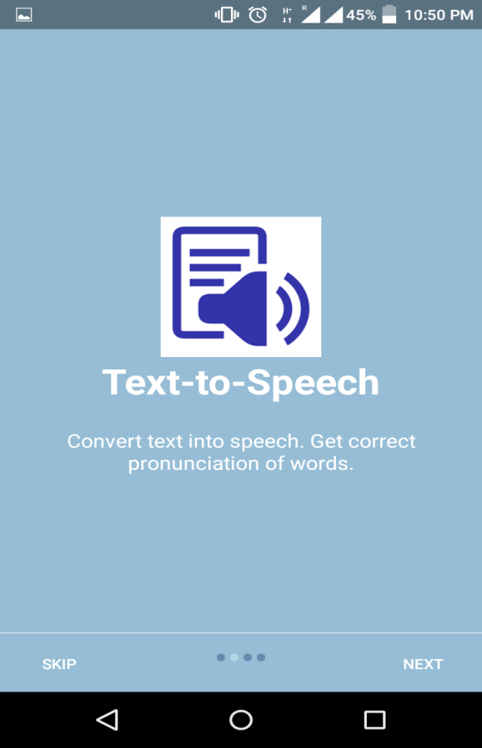
Text-to-speech
User can scan any text and easily get the pronunciation of words.
Done using Android vision text (ocr- optical character recognition) API.
Get pronunciation easily, just by tapping on the mobile phone screen.

Slide 10
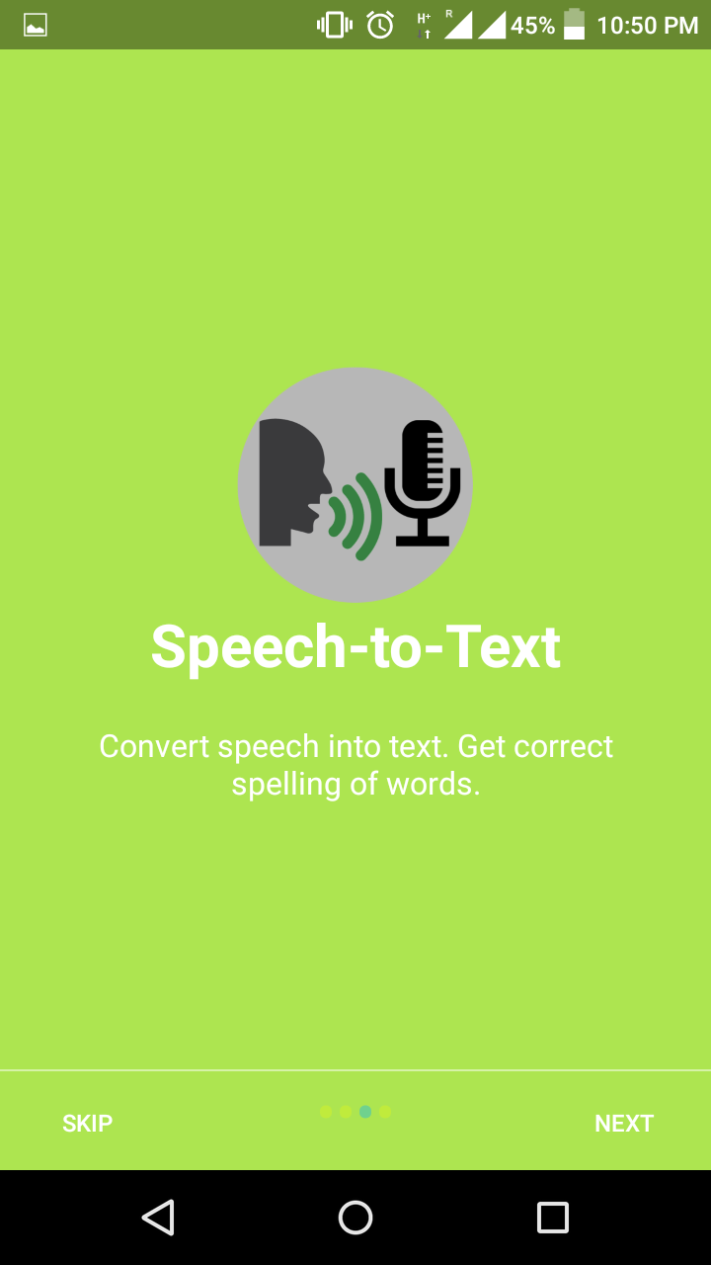
Speech-to-Text
In this part of the application, users can get spelling of any word.
Google API and interfaces have been used.

Slide 11
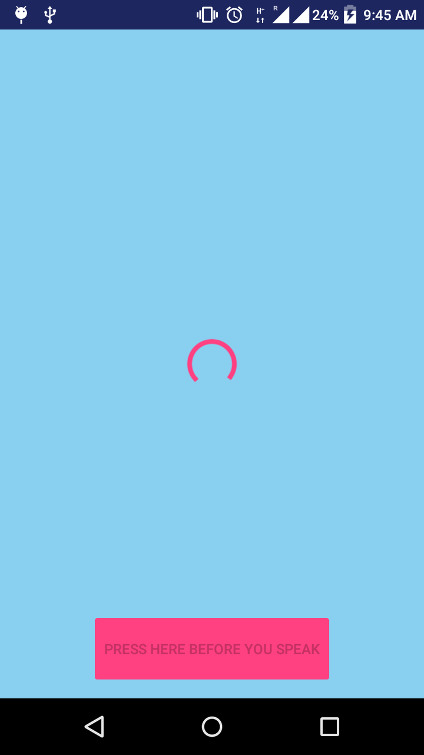
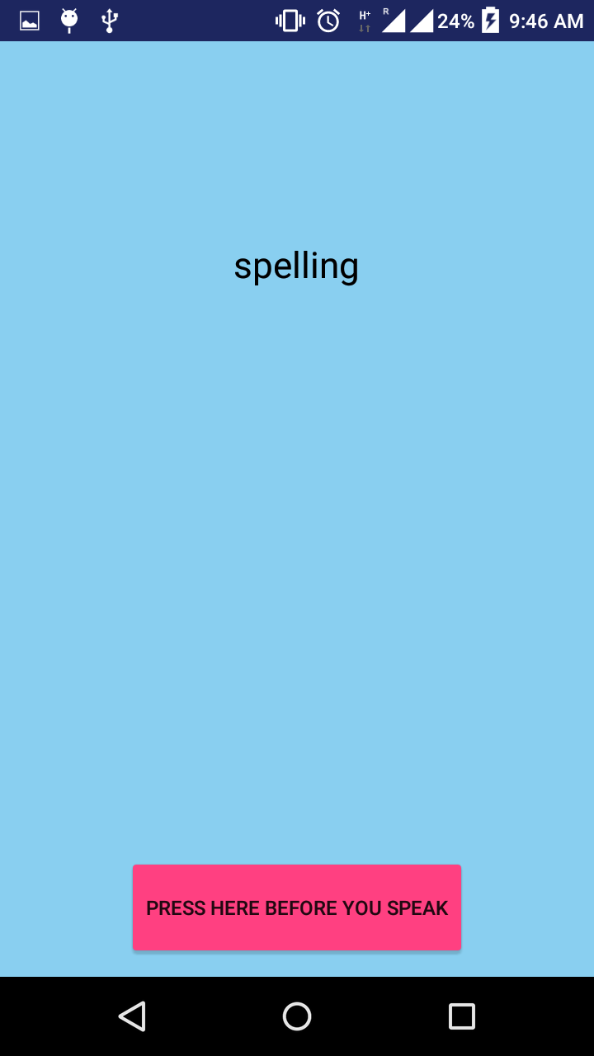
Speech-to-Text

Slide 12
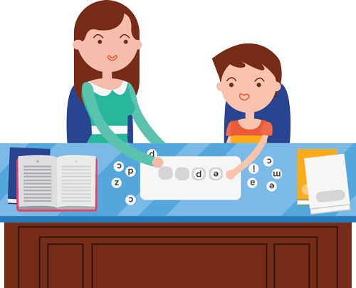
Practice
Regular practice can help dyslexics a lot to reduce their confusions.
They can find the spellings and pronunciation of the words by using text-to-speech and speech-to-text and also store those words for further practice.
Can practice both spellings and pronunciation regularly and properly.

Slide 13
Future plans
We can make a web-application .
We can include some games.
Also including different designs for different age groups.

Slide 14
References
Research Paper(2014): Educational multimedia app for dyslexia literacy intervention: a preliminary evaluation Aznoora Osmana*, Wan Ahmad Jaafar Wan Yahayab, Aznan Che Ahmadb aUniversiti Teknologi MARA Perlis, Arau, 02600, Malaysia bUniversiti Sains Malaysia, Pulau Pinang,11800, Malaysia
Research Paper(2015): Dyslexia Friendly Reader Prototype, Designs, and Exploratory Study Dominik Lukeš Research, Development and Policy, Dyslexia Action dlukes@dyslexiaaction.org.uk
Research Paper: Evaluation of DysWebxia: A Reading App Designed for People with Dyslexia
Luz Rello Web Research Group & NLP Research Group Universitat Pompeu Fabra Barcelona, Spain luzrello@acm.org
Ricardo Baeza-Yates Yahoo Labs Barcelona & Web Research Group Universitat Pompeu Fabra Barcelona, Spain rbaeza@acm.org

